Slide 1
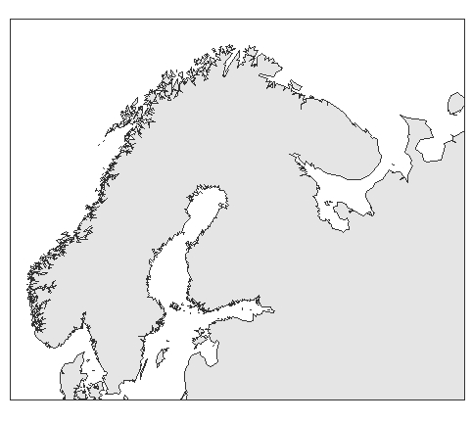

Slide 2
White Sea

Slide 3
White Sea
Kandalaksha Bay

Slide 4
